Slide 1

Data Governance & Security Data Analysis
A comprehensive look at the principles, practices, and technologies that ensure your data is secure, compliant, and valuable.

Slide 2
Overview of Data Governance
Data Governance Framework
Key Goals
A set of policies, processes, and tools that ensure the availability, integrity, and security of your data.
Establish data ownership, define data usage guidelines, enforce compliance regulations, and maintain data quality.

Slide 3
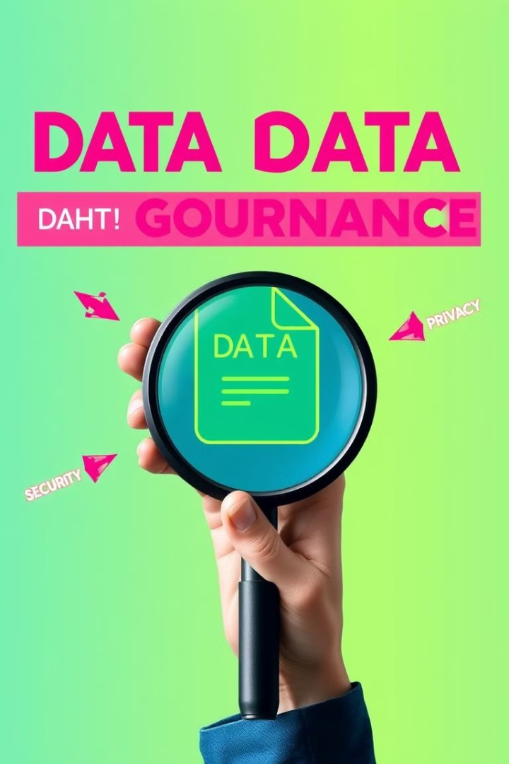
Key Elements of Effective Data Governance
Data Inventory
Data Policies and Standards
A comprehensive list of your data assets, including their location, format, and ownership.
Clear guidelines for data usage, access, and security that ensure consistency and compliance.
Data Quality Management
Data Security Measures
Processes to ensure that data is accurate, complete, and consistent, improving the reliability of your data analysis.
Robust controls to protect your data from unauthorized access, disclosure, or modification.

Slide 4

Data Security Best Practices
Access Control
Data Encryption
Implement strong authentication and authorization mechanisms to limit access to sensitive data.
Encrypt data at rest and in transit to protect it from unauthorized access.
Regular Security Audits
Data Backup and Recovery
Conduct periodic security assessments to identify and address vulnerabilities.
Develop a comprehensive data backup and recovery plan to minimize data loss.

Slide 5



Identifying and Mitigating Data Risks
Risk Assessment
1
Identify potential data risks, evaluate their likelihood and impact, and prioritize them based on severity.
Risk Mitigation Strategies
2
Implement controls to reduce or eliminate data risks, such as access control, data encryption, and security training.
Continuous Monitoring
3
Monitor data security systems and practices to detect and respond to emerging threats.

Slide 6
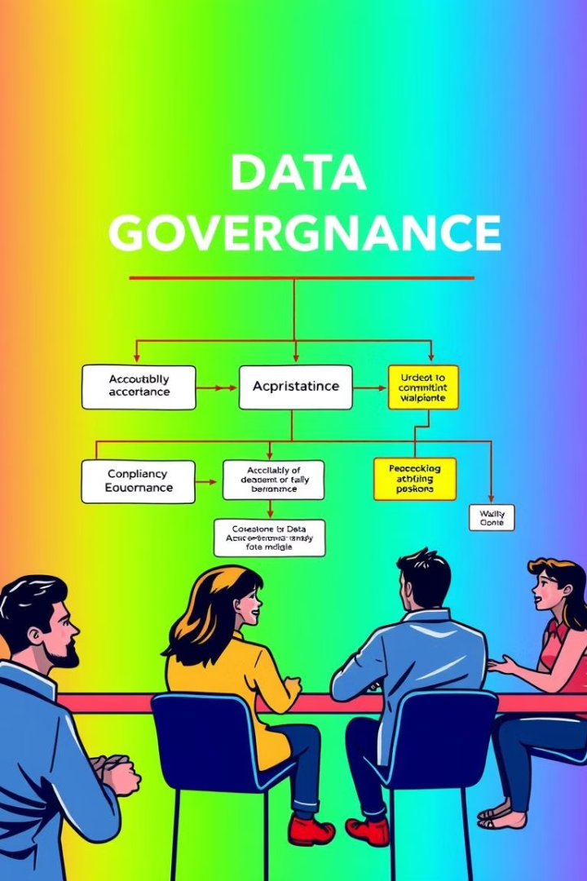



Driving Accountability and Compliance
Data Ownership
Regulatory Compliance
Assign clear data ownership and responsibilities to individuals or teams for specific data assets.
Ensure that data handling practices comply with relevant regulations, such as GDPR, HIPAA, and CCPA.
Data Security Training
Provide regular data security training to employees to raise awareness and promote best practices.

Slide 7

Leveraging Data Analytics for Governance
1
Data Quality Analysis
Use analytics tools to identify and address data quality issues, such as inconsistencies, duplicates, and missing values.
2
Data Usage Monitoring
Track data access patterns and usage trends to identify potential security breaches or compliance violations.
3
Data Risk Analysis
Leverage analytics to assess the likelihood and impact of potential data risks, and prioritize mitigation strategies.

Slide 8
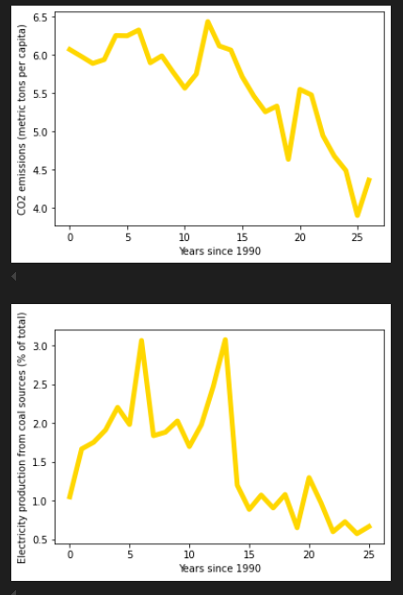
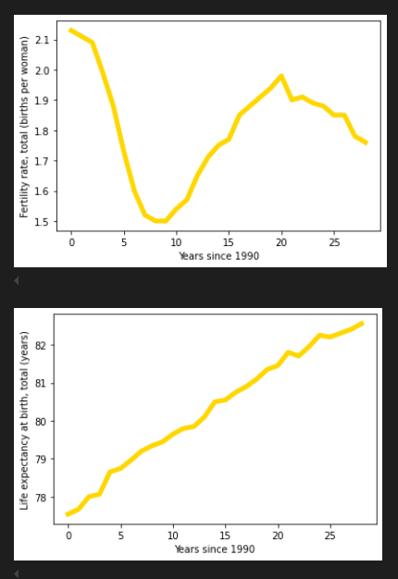

Slide 9
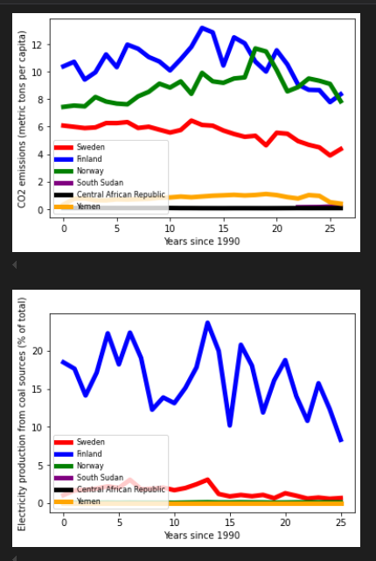
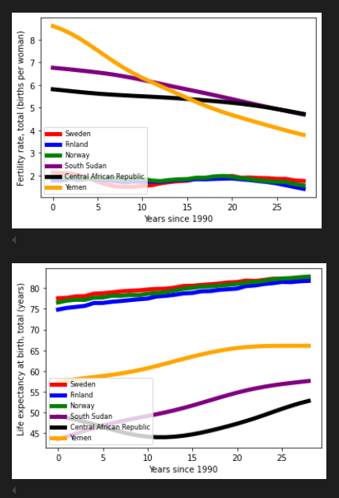

Slide 10
Implementing a Data Governance Framework
Define Data Governance Objectives
1
Clearly define the goals and scope of your data governance program.
Develop Policies and Standards
2
Establish data usage, access, and security guidelines that align with your objectives.
Implement Data Governance Tools
3
Choose and deploy data governance tools to automate key processes and enhance efficiency.
Monitor and Evaluate
4
Continuously monitor the effectiveness of your data governance framework and make adjustments as needed.

Slide 11

Conclusion and Next Steps
Data governance is an ongoing process that requires continuous effort and adaptation. By establishing a strong data governance framework, you can ensure that your data is secure, compliant, and valuable for your business.

